Slide 1


Data
Team: 5G

Slide 2
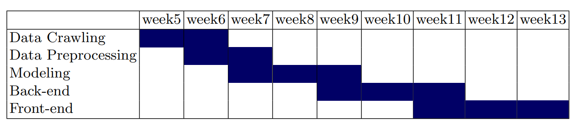
Part 2
Data analysis
Progress schedule

Slide 3

List
table of contents
1
Web crawling
2
Data analysis
ⓒSaebyeol Yu. Saebyeol’s PowerPoint

Slide 4


Part 1
Web Crawling
ⓒSaebyeol Yu. Saebyeol’s PowerPoint

Slide 5
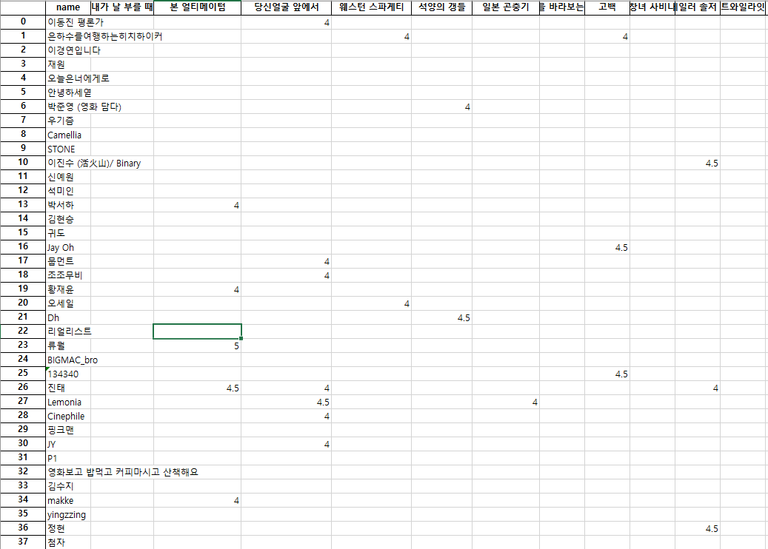
Part 1
Data Crawling

Slide 6
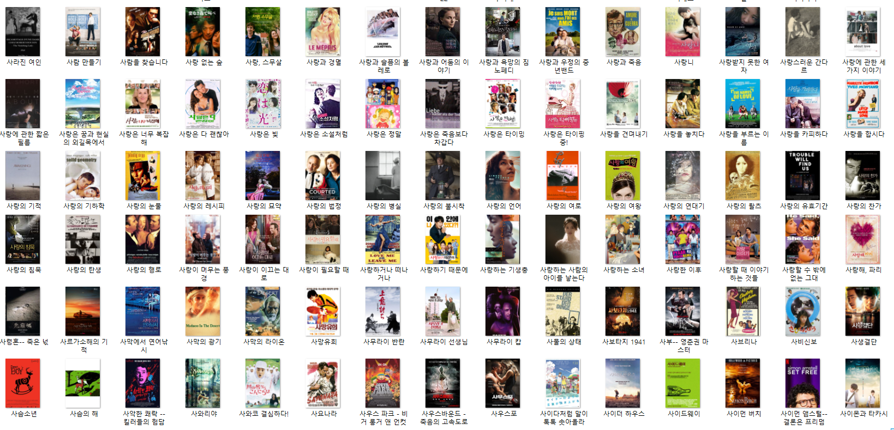
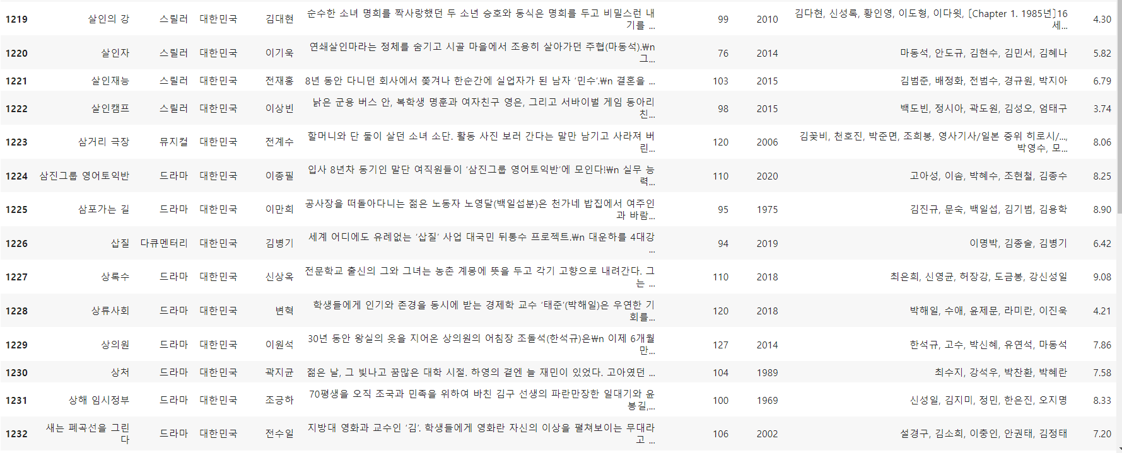
Part 1
Data Crawling

Slide 7

Part 2
Data analysis
ⓒSaebyeol Yu. Saebyeol’s PowerPoint

Slide 8
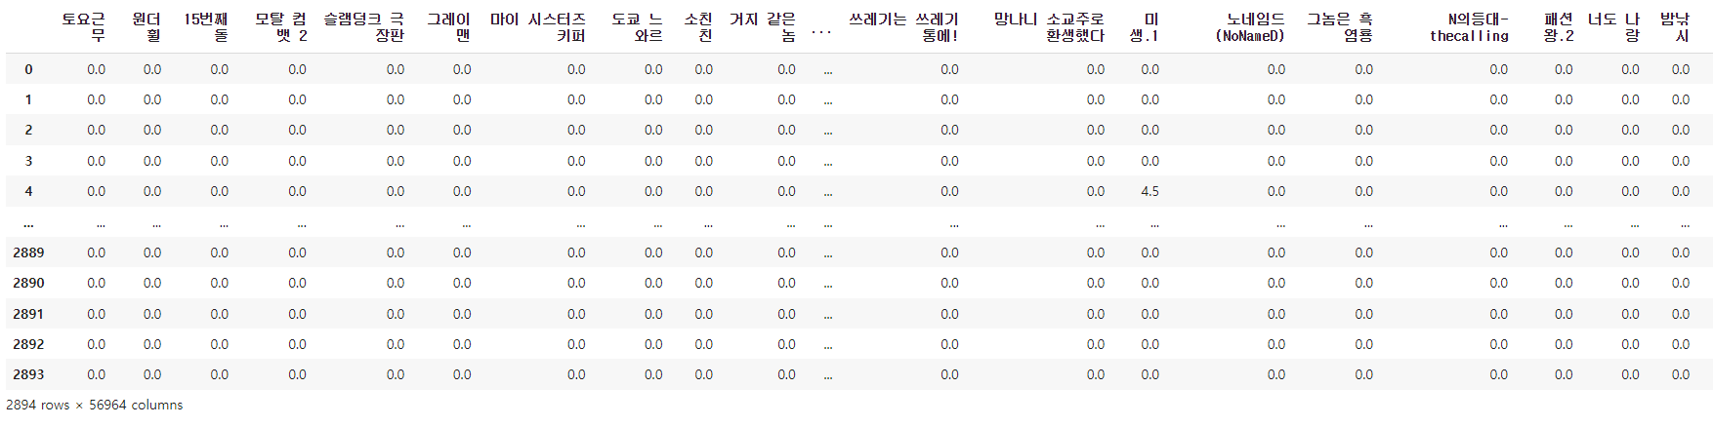
Part 2
Data analysis
Data processing
Fill nan value to 0
5650 users, 60000 items

Slide 9
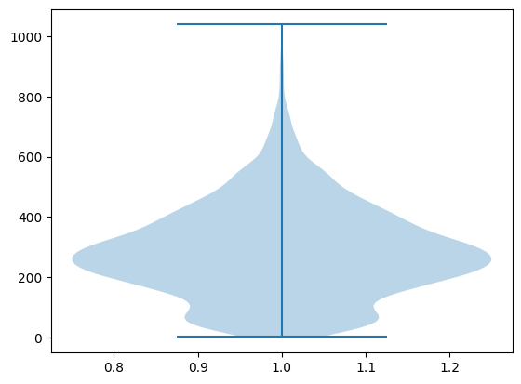
Part 2
Data analysis
User information
The user who evaluated the most did it 1039 times.
The user who gave the least evaluation did it once.
On average, 286.82 evaluations were conducted per user.

Slide 10
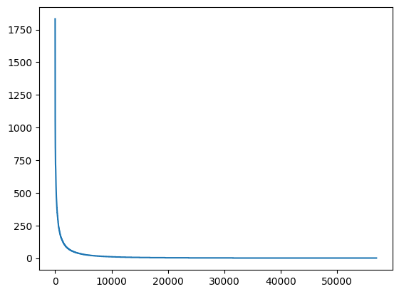
Part 2
Data analysis
Contents ratings
It shows a very biased graph.
The content that received the most evaluation was rated 1832 times.
and that content is “기생충”
The content that received the least evaluation was evaluated once.
Overall, there was a lot of data about the movie.

